Slide 1

















Social Data Mining
Tools and techniques for real time
data collection
Assignment 2

Slide 2
Agenda
1
About Me
2
Data Collection
3
Data Model
4
Storing the data
5
Web Application

Slide 3

About Me
Dhruval Domadiya
Graduated in Computer Engineering
Contact:
Dhruval.Domadiya@MyGeorgian.ca

Slide 4
Social Media Platforms
Twitter
Reddit

Slide 5







Tools and Technologies
tweepy

Slide 6
Data Model
Twitter
Reddit
ID
Unique Identifier
ID
Unique Identifier
Source
Source of the post
Title
Title of the post
Tweet Text
Text of the tweet
Description
Text user posted
Time
Time of the tweet posted
Score
Score for the post
Likes
No. of likes for post
Timestamp
Time of the post created

Slide 7
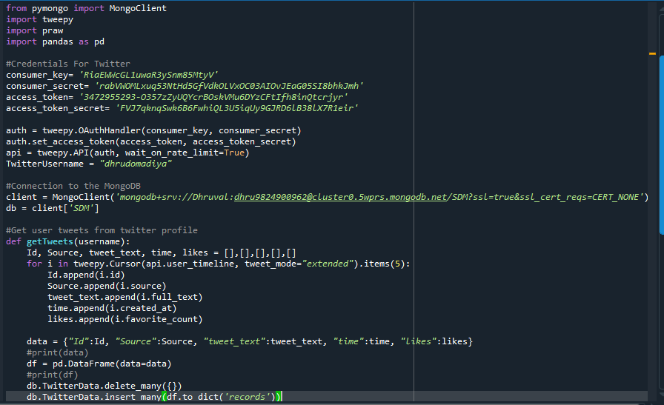
Data Collection Twitter

Slide 8
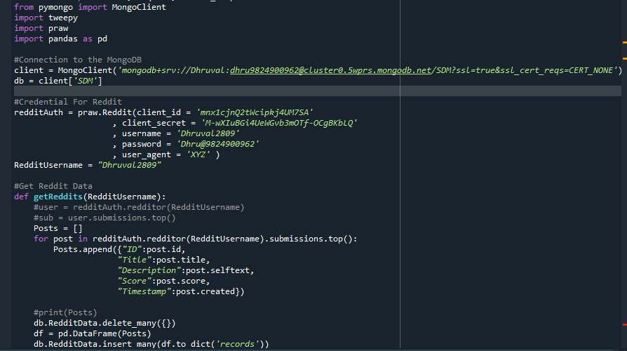
Data Collection Reddit

Slide 9
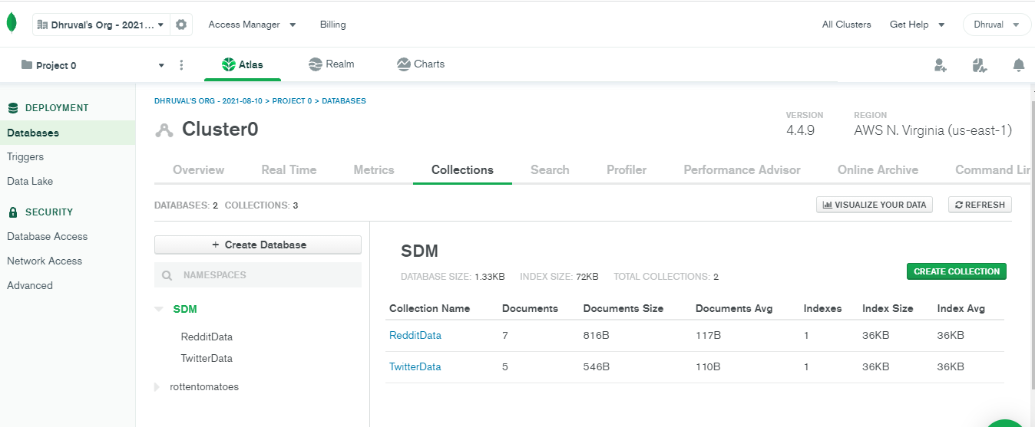
Store Data to MongoDB

Slide 10
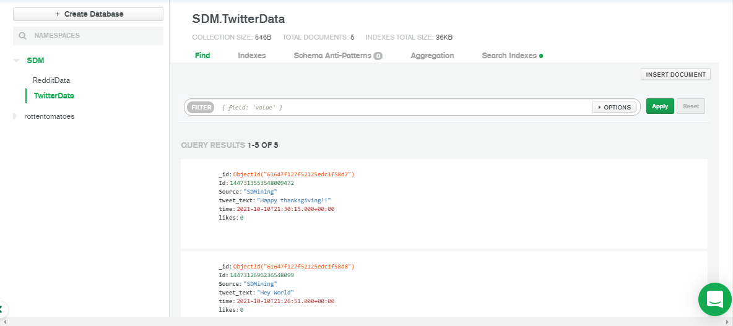
Sample Twitter Data

Slide 11
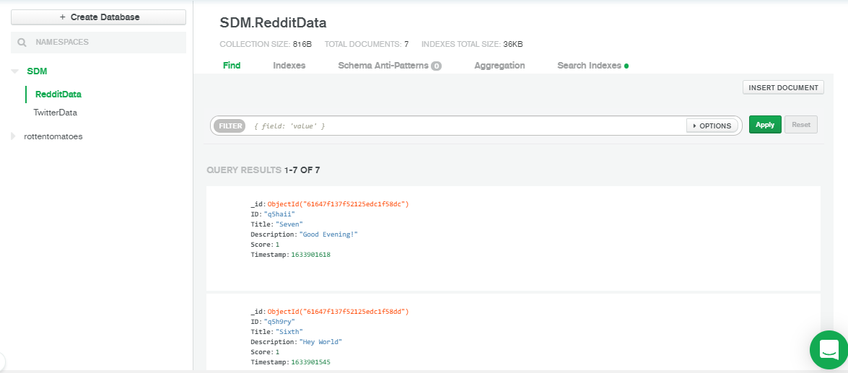
Sample Reddit Data

Slide 12
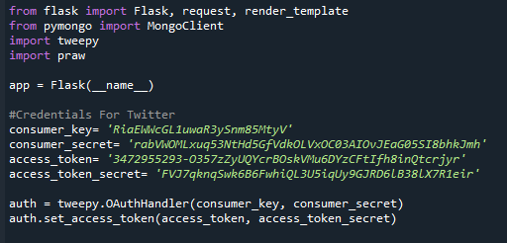
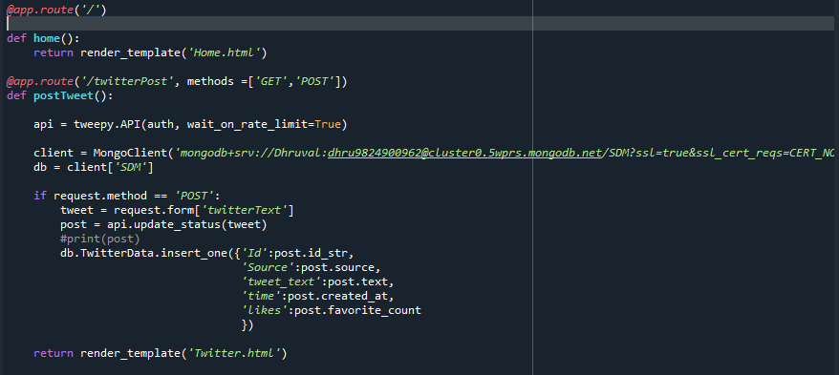
Flask App Code for Twitter

Slide 13
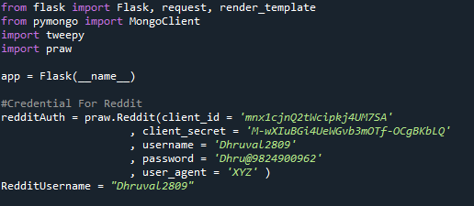
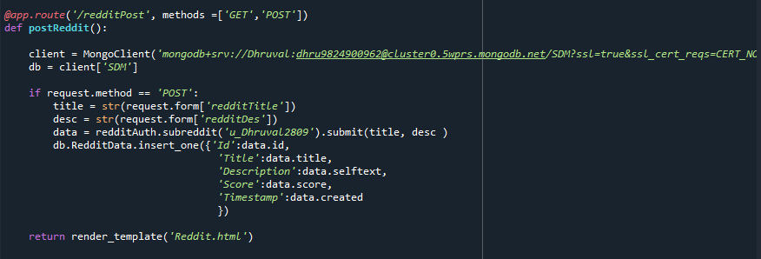
Flask App Code for Reddit

Slide 14
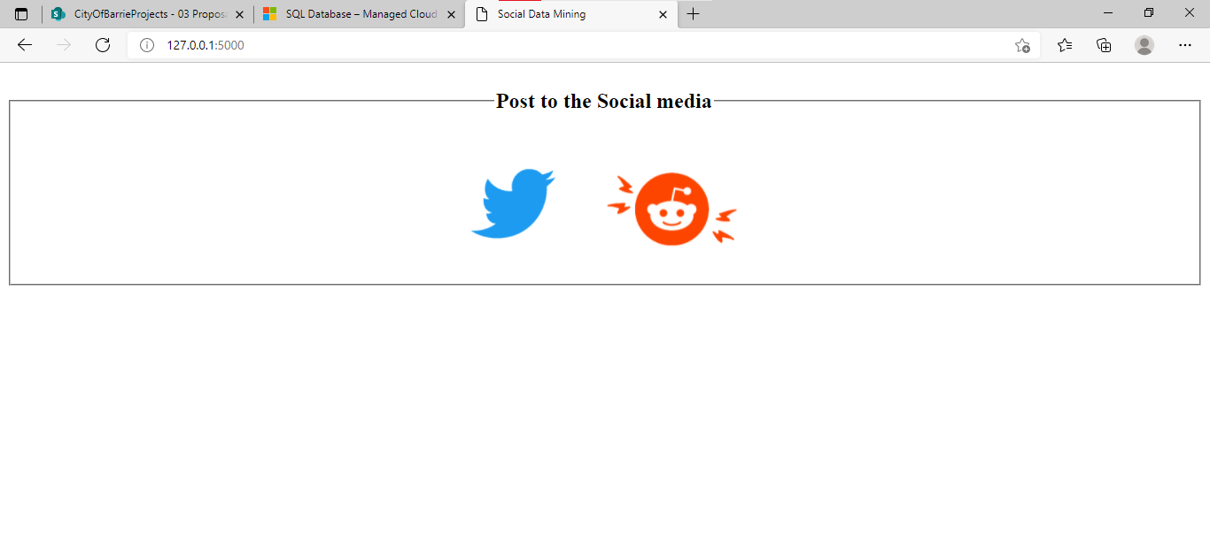
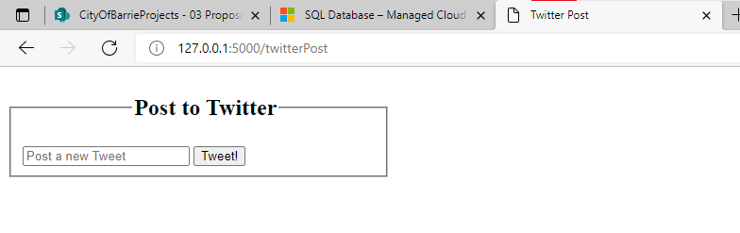
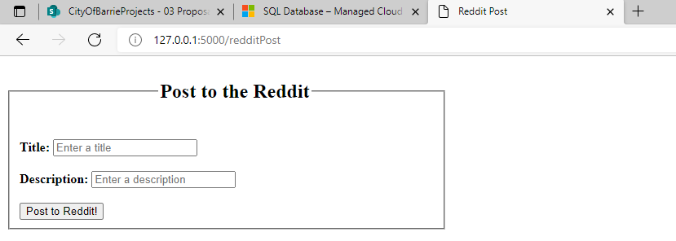
Web Application

Slide 15
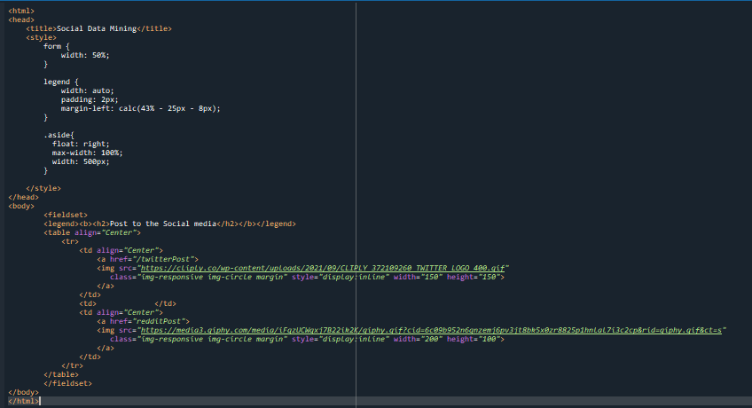
HTML Code for Home Page

Slide 16
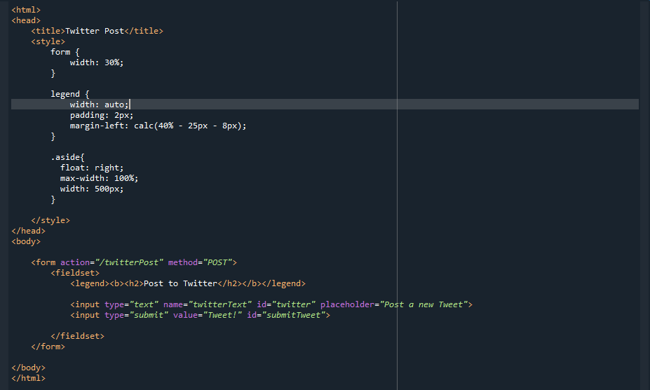
HTML Code for Twitter Page

Slide 17
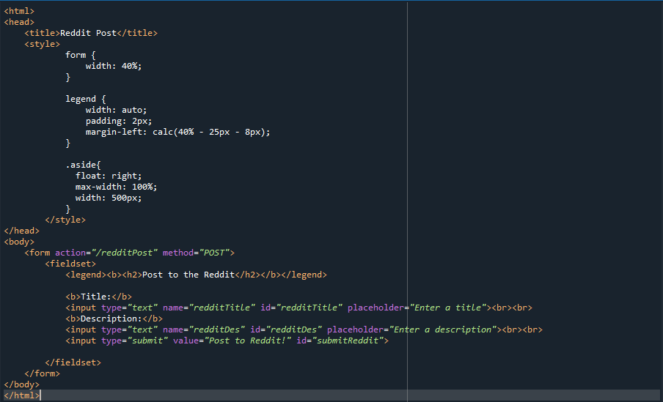
HTML Code for Reddit Page

Slide 18
Links
YouTube Video Link
https://youtu.be/6i4TNhVrdgY

Slide 19


